Slide 1

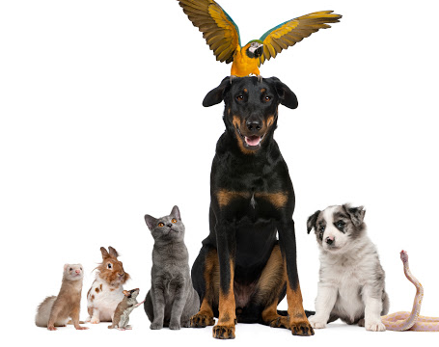
The Battle of Neighborhoods
--- Where to Build New Pet Store in Houston, Texas, USA
Dan Wang
August 21, 2020

Slide 2


1 Introduction
Where to Build New Pet Store in a city is valuable to pet store owners, pet organizations, pet owners, etc.
pet related organizations or stores are not evenly distributed in neighborhoods compared to the abandoned location distributions.
Datasets include Houston BARC dog intake table and Foursquare pet venues.
Segmentation and custering is used to separate Houston areas into groups, based on which to choose new pet store locations.

Slide 3
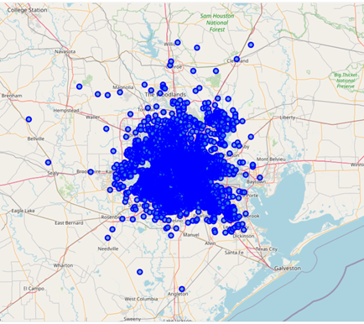
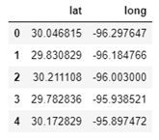
2 Data Acuisition, Cleaning and EDA
List of Houston Super Neighborhoods can be found in the Wikipedia page.
Open Data Houston published data on BARC Dog Intakes for Calendar Years 2011 and 2012.
Original table includes more than 30000 instances.
2 features are kept: latitude and longitude
Original Houston BARC Dog intake location data distributions

Slide 4
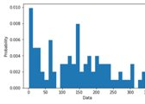
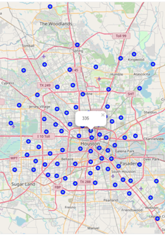
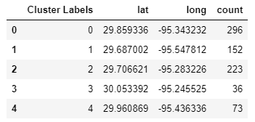
2 Data Acuisition, Cleaning and EDA – cont'd
Original intake instances are clustered into 88 groups based on location
the total number of intakes is calculated as the “count” column
A histogram chart is shown
For each “Neighborhood”, dog intakes are shown with the intake number as popup

Slide 5
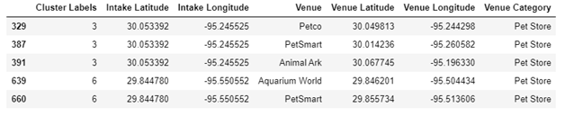
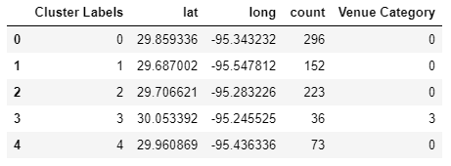
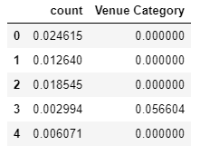
3 Clustering
Foursquare venues
Segmentation and clustering is used to separate neighborhoods into groups
Algorithms: KMeans modeling. Number of clusters: 4
2 features are used to fit the model: intake numbers (count) and pet store count (venue category)
combined dataframe
normalized training dataframe

Slide 6
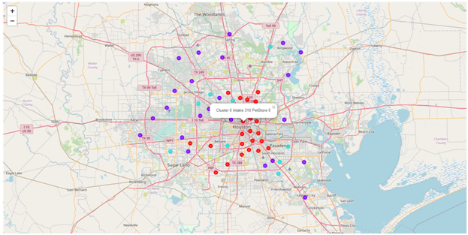
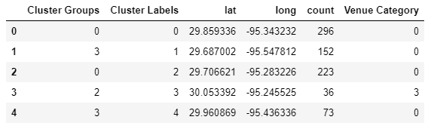
4 Results
4 clusters:
Cluster 0 Large amounts of intakes areas, small amount of pet stores
Cluster 1 Small amount of intakes areas, large amount of pet stores
Cluster 2 Large amount of intakes areas, large amount of pet stores
Cluster 3 Small amount of intakes areas, small amount of pet stores

Slide 7
5 Conclusions
Houston areas are clustered into 4 groups.
Areas in the 1st group (Cluster 0 Large amounts of intakes areas, small amount of pet stores) are best places to build new pet stores.
Because of the large amounts of dog intakes and little numbers of pet stores, any new built pet store in this group will help ease the demand and supply relationship.

